Slide 1
ECE 2140 SOC Design Convolution Neural Network on FPGA Theta
1 min
Thibaut Lanois: THL26@pitt.edu
Wen Wen: WEW55@pitt.edu
Pan Jieming: JIP40@pitt.edu

Slide 2
CNN Overview
3 min
Convolutional layers account for over 90% computation
FPGA has inherent parallelism
Convolution layer + Pooling layer
Fully connected layer
FIFO
Controller
Router

Slide 3
SoC System Architecture

Slide 4
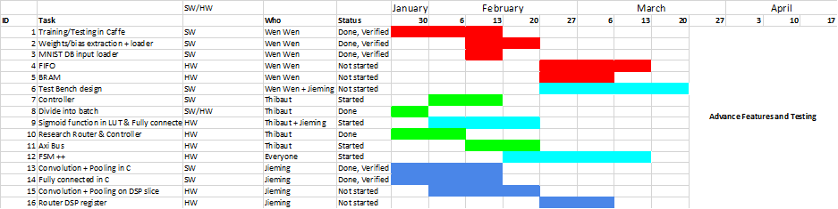
<CNN on FPGA theta> Overview
2 min
Schedule and Status
Accomplishments last week:
Finished Software & Training & Testing
Working on this week:
Hardware implementation
Challenges/ Difficulties / Needs
Software part as near as we can than the hardware but we don’t start the hardware so a bit late

Slide 5
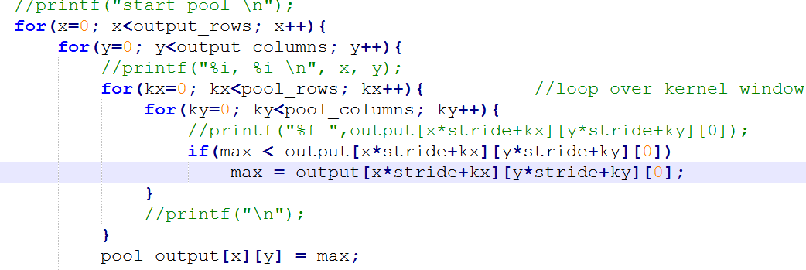
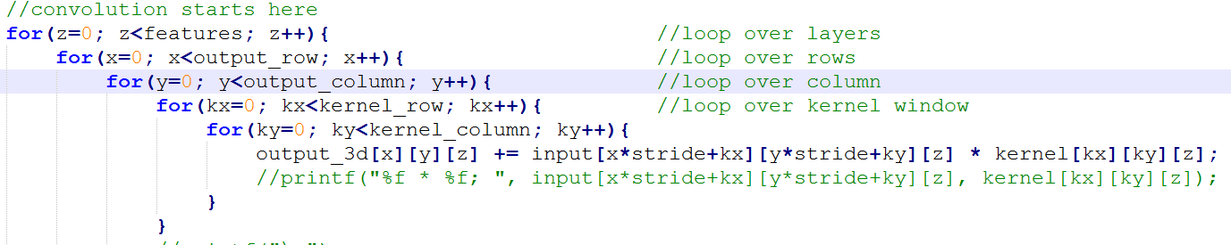
<CNN on FPGA theta> - Convolution + pooling layer
2 min
This block is used to accelerate the computation of convolution of the kernels over the feature map (hardware)
Bias, Kernel, Feature maps
New pooled feature maps
5 for loop for convolution; multiplication followed by summation and selection of the highest value.
45 lines convolution, 25 lines pooling
Jieming
3/13/17

Slide 6
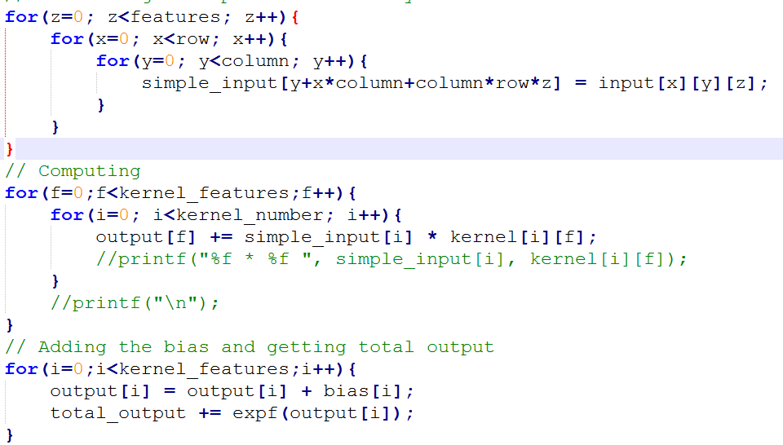
<CNN on FPGA theta> - Fully connected layer
2 min
This block is used to accelerate the computation of the multiplication of 4D matrix (hardware)
Bias, Kernel, Feature maps
1D output
Matrix Multiplication and three activation function (ReLu, Sigmoid, SoftMax or nothing.
56 lines
Jieming
3/20/17

Slide 7
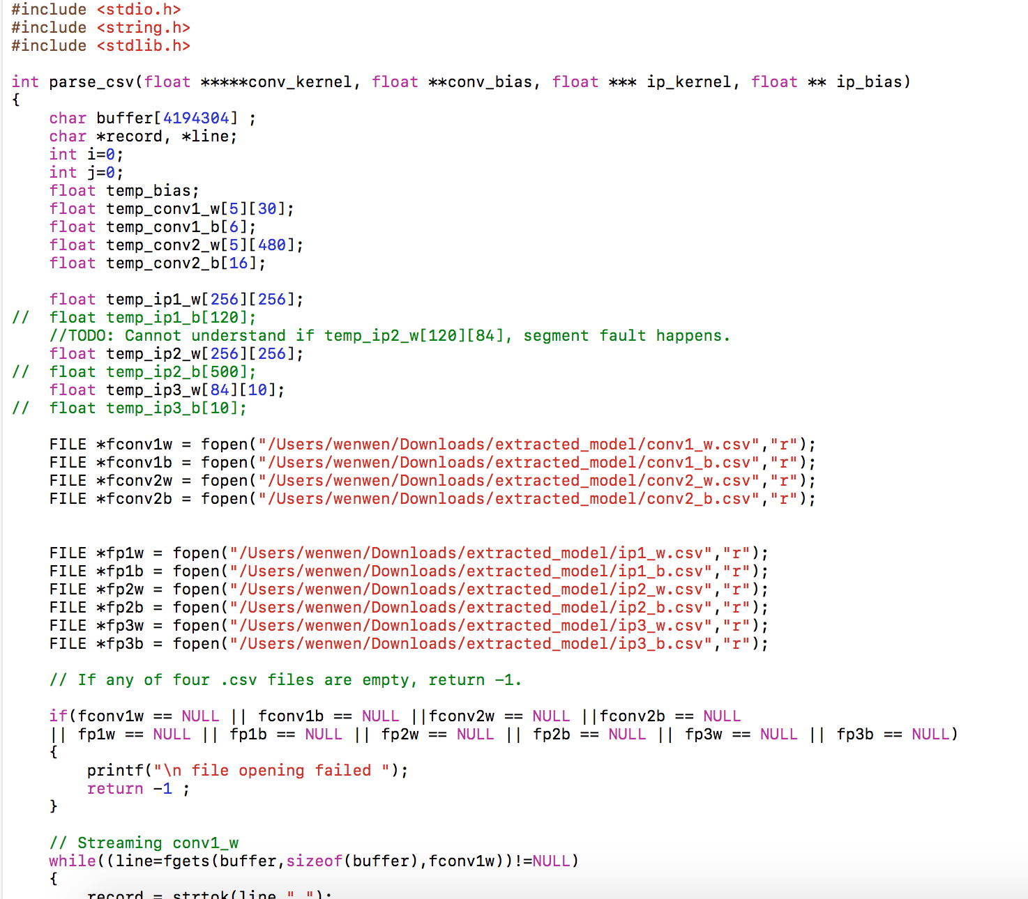
<CNN on FPGA theta> - FIFO
2 min
This block is used to enable the parallelism in computation (hardware + software)
Weights, Biases and Feature maps from block memory
Maximum datasets that can be used for computation
Extract data from text file to matrix
~350 lines of C codes and ~50 matlab codes
Wen
3/13/2017

Slide 8
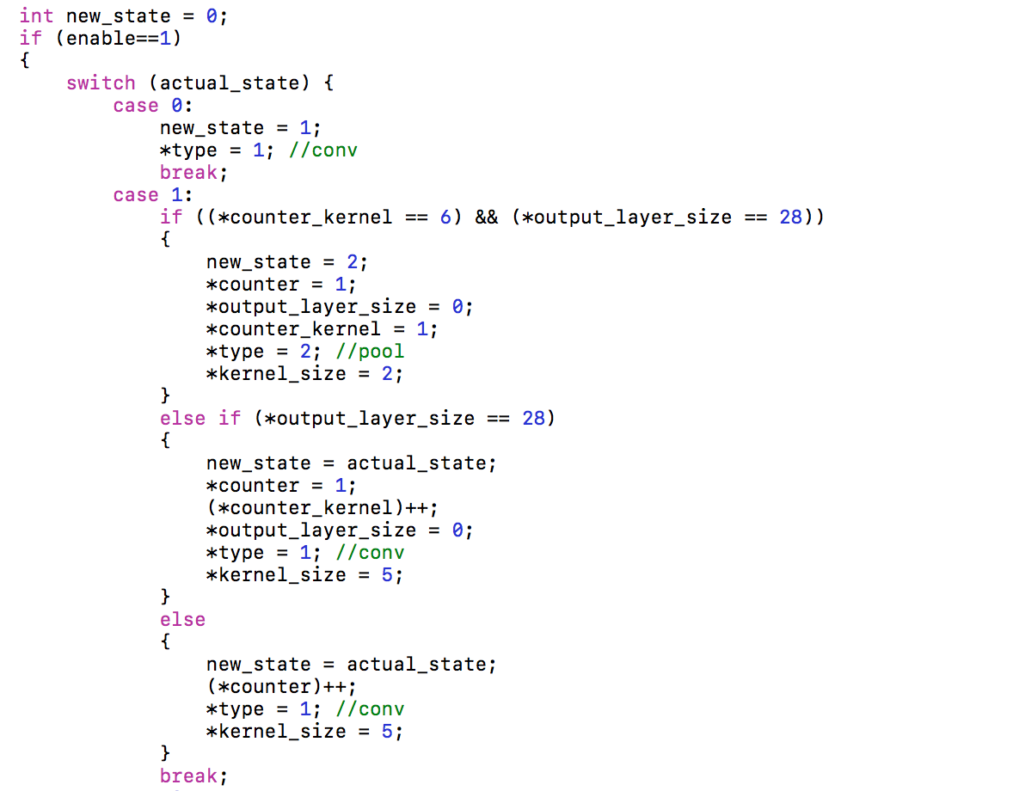
<CNN on FPGA theta> - Controller
2 min
This block is used to divide into batch, switch between batches, select computation units in order to facilitate process flow (hardware)
CPU signals for activation and reset
Control signals
Setting up all control signals +
switch between states
300 lines of codes
Thibaut
03/17/2017

Slide 9
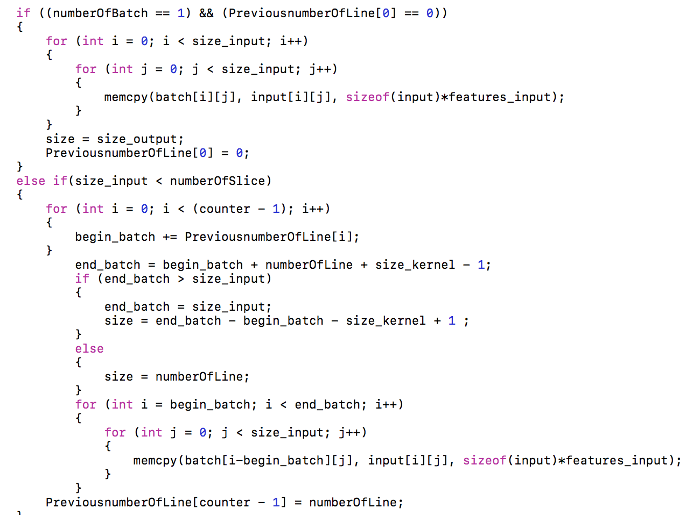
<CNN on FPGA theta> - Router
2 min
This block is used to facilitate data propagation
data flow
In order to mimic the hardware we divide our software part into batch
150 lines of codes
Thibaut
03/13/2017

Slide 10
<CNN on FPGA theta> Summary
5 min
Accomplishments last week:
Finished Software & Training
Verification software with Matlab library
Challenges/ Difficulties
Software part as near as we can than the hardware but we don’t start the hardware so a bit late

Slide 11

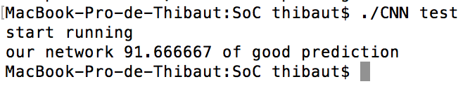
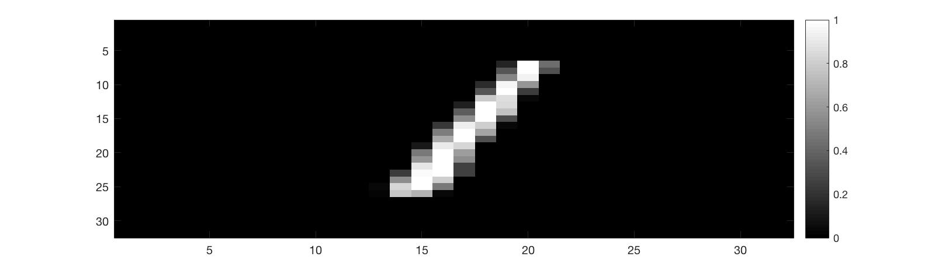
<CNN on FPGA theta> - Simulation
Our C code is done and works as we expected

